Slide 1
The Battle Of Neighborhoods

Slide 2
Introduction
The purpose of this project is to explore and identify the best hotels in New York City for the tourists who plan for a trip and stay for a while. The target audience for this project will be travelers who might plan in future to visit NYC and look for the best hotel to stay. This will help them take better decision on selecting the best hotel to enhance their experience on their visit to New York City.

Slide 3
According to the sources
Bureau predicts that there were around 67 million tourists in New York City in 2019.
New York City is one of the world's leading metropolises for art, fashion, food and theater.

Slide 4
Motive of the project
This project will analyze the best hotels for staying. Factors that will be kept in mind while analyzing will be – surroundings, location, ratings, restaurants nearby, reviews etc. This project will help you in making right decision so that you do not have regret after making wrong decision.

Slide 5
Inquiry Questions
What are some best hotels in New York City?
Visualize parts of New York City that has best hotels
Which hotels are cheap and have a good rating?
Best Hotels which are nearby airport
Hotels which are nearby best restaurants
Best Hotels which are nearby Subway Station

Slide 6
Data Section
We will be only using Foursquare API to find the best hotels in each neighborhood.
Foursquare API
By the help of Foursquare API, we would be able to get hotels and their latitude and longitude of hotels.
Also, Foursquare API would also be used to locate restaurants, subway stations and airport.
After this, data can be filtered on the basis of ratings by which we can make a choice for the best hotel.

Slide 7
Methodology
We will get the details of hotels from the Foursquare API that is located in New York City.
We will filter the data and represent it in a dataframe in a clean way.
We will get the ratings and average price of each hotel from Google as Foursquare API didn’t had enough data to establish the ratings of each hotel and store it in a list in the notebook and further add it in the dataframe.
We will filter the data with the best ratings (greater than or equal to 9.0).
By the help of Folium, we will visualize this data on a map.

Slide 8
Methodology
Now we will filter the data by decent ratings (greater than 8.0) and by cheaper price (less than 150 dollars)
The data would be visualized onto a map
Airport would be located with the help of Foursquare API and then a map would be created in which the location of airport and hotels would be combined to see hotels near airport.
Similarly, Foursquare API would be used to find restaurants in New York City and ratings would be extracted from Google, then the data would be filtered to find the best restaurants and then the data would be represented onto the map.
Again, Foursquare API would be used to get all the location of subway stations and then hotel data and subway station data would be combined in the map.

Slide 9
Answers
Answer 1: The best hotels in New York City are:
'Four Seasons Hotel New York Downtown',
'The Beekman, A Thompson Hotel',
'Gild Hall, A Thompson Hotel'
'Cosmopolitan Hotel - TriBeCa‘
Answer 3: The best and cheap hotels are
The Beekman, A Thompson Hotel
Artezen Hotel
Cosmopolitan Hotel - TriBeCa
Smythe Thompson Hotel
Holiday Inn New York City - Wall Street

Slide 10
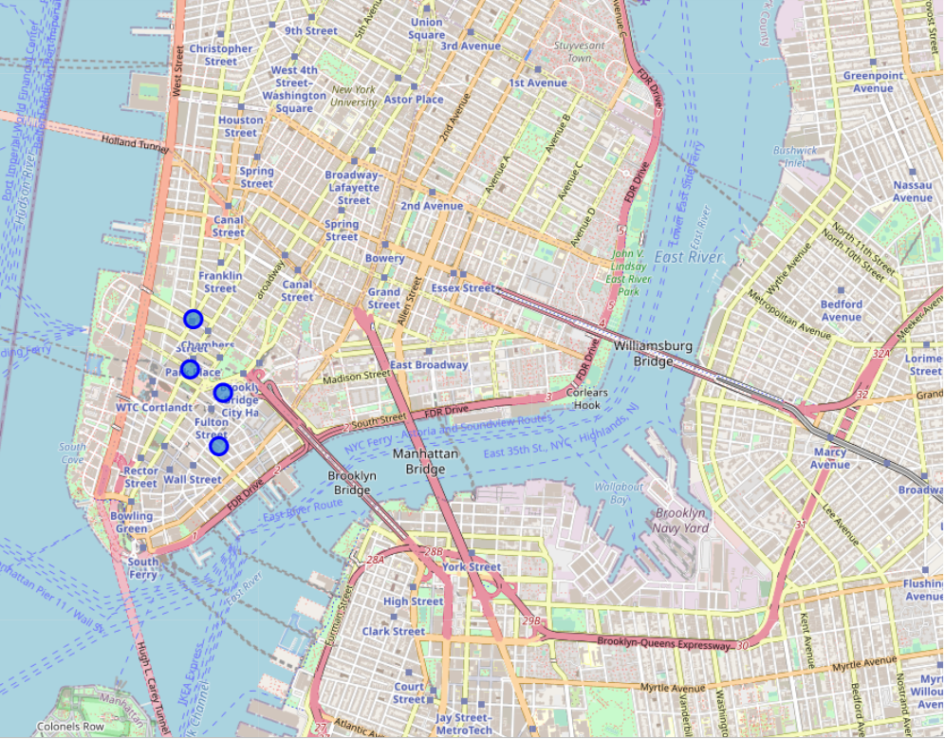
Answer 2
Visualization of the map showing the best hotels of New York City

Slide 11
Answers (Conclusion)
Answer 4: The best hotels nearby airport
'Four Seasons Hotel New York Downtown' (454 dollars)
'Millennium Hilton' (250 dollars)
Answer 5: Hotels nearby best restaurants are:
'Gild Hall, A Thompson Hotel'
'The James Hotel'
'Cosmopolitan Hotel - TriBeCa'
'The Frederick Hotel'
'Smythe Thompson Hotel‘
Answer 6: All the hotels were found near subway station

